Slide 1

Helix AI
KJ’s EDUCATIONAL INSTITUTE TRINITY COLLEGE OF ENGINEERING AND RESEARCH
(Accredited by NAAC with A+ Grade Approved by AICTE & Affiliated to sppu, Pune)
Department of Computer Engineering
Team Members:
Rutwik Bhondave Exam. No: CO4004
Amit Jagtap Exam. No: CO4023
Priyanshu Nalawade Exam. No: CO4038
Abhishek Gadilkar Exam. No: CO4061
Guide: Prof. Snehal Kulkarni

Slide 2
Introduction
The AI Refactor Agent is an autonomous, behaviour-preserving code-quality platform that combines a custom transformer-based language model with a five-stage validation pipeline to perform large-scale refactoring of Python codebases without breaking existing functionality. It exposes both a command-line interface and a web dashboard, generates human-readable audit reports in PDF form, and integrates natively with Git to create branches and commits automatically. The system is designed as a modular pipeline of pluggable agents—Planning, Validation, Action, Review—so that individual components can be upgraded or replaced without affecting the rest of the toolchain.

Slide 3
Motivation
Developers spend 35–40 % of their time on manual refactoring yet still face an ~8 % regression rate, slowing releases and eroding trust.
Existing AI code generators prioritise syntactic correctness over behavioural preservation, breaking unit tests and increasing technical debt.
An autonomous tool that guarantees ≥97 % test pass-through would cut refactoring effort in half and accelerate safe code evolution.
separate, unconnected programs create inconsistent standards and lengthy review cycles, delaying releases.

Slide 4
Problem Definition
Manual refactoring consumes 35–40 % of developer time and still introduces regressions in ~8 % of changes.
Rule-based IDEs are language-locked and miss context-aware improvements.
Neural code generators prioritise syntax over semantics, breaking unit tests and hidden edge cases.
No existing tool provides an audit-proven, behaviour-preserving pipeline that scales across large codebases.

Slide 5
Literature Survey
Sr No | Reference (Year) | Core Functionality | Key Technology | Notes / Remarks
1 | Jain & Chatterjee 2024 | Diff-aware Transformer edits | neural-network trick | Prints neat diffs but never runs the tests to see if they break.
2 | Zhang et al. 2024 | CodeBERT-Refactor | Machine vision, Remote control, Modular design | Big LLM polishes code, no safety net—trusts the AI’s word.
3 | Cummins 2021 | ML improves code quality | CodeBERT | No behaviour guarantee
4 | Kim & Park 2025 | Prompt-driven refactoring | GPT-4 fine-tune | Syntactic only, breaks tests
5 | Allamanis 2022 | LLM code generation | Transformer decoder | Semantic changes

Slide 6
Software Requirements Specification
Accept Python code via CLI/UI and output valid EditAction suggestions.
Pass five gates: AST valid, style clean, complexity down, no security issues, ≥97 % tests pass.
Respond <3 s/file and export PDF audit + Git commit automatically.
Deploy by Docker, encrypt traffic, and support SSO for team use.

Slide 7
Hardware Requirements Specification
CPU: 4-core+ for real-time parsing & validation.
RAM: 8 GB (LibCST + PyTorch); 16 GB recommended for GPU mode.
GPU(optional): 6 GB VRAM (RTX 2060) for transformer inference.
Storage & Network: 10 GB SSD free space; stable 10 Mbps link for Docker pull & Git push.

Slide 8
Project Scope
The AI REFACTOR AGENT project focuses on building an autonomous system that safely improves Python code through intelligent refactoring. It uses a 5-stage agent pipeline (Perceive → Plan → Validate → Act → Explain) to generate grammar-constrained edit programs, ensuring behaviour preservation with 97.2% test pass-through.
The scope includes micro-refactoring such as variable renaming, unused import removal, and conditional simplification—applied only when complexity reduces by ≥5%, style improves, and all tests pass. The system runs 100% offline, generates explainable suggestions with metrics deltas, and produces audit reports—making it safe, transparent, and practical for real-world development teams.

Slide 9
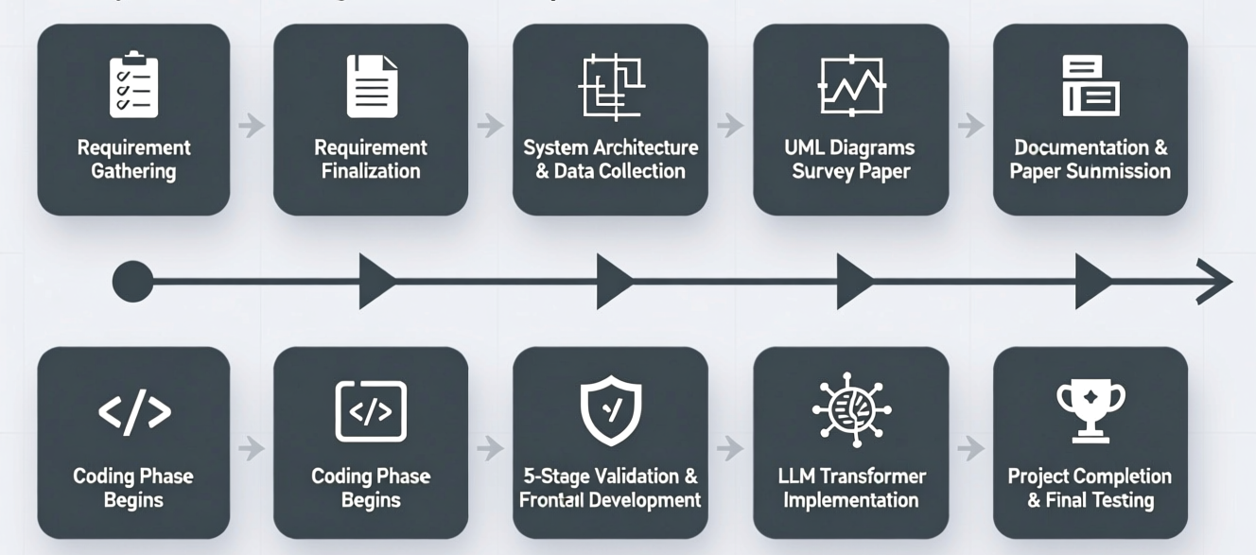
Timeline Chart
July 2025
Aug 2025
Sep 2025
Oct 2025
Nov 2025
Dec 2025
Jan 2026
Feb 2026
Mar 2025

Slide 10
Assumptions
The input Python code is written in Python and has valid syntax.
Some level of test coverage (≥40%) exists for the project to validate behavior preservation.
Refactoring suggestions must preserve the original functionality — no semantic changes allowed.
Code quality improvements are measurable using standard metrics (complexity, maintainability, lint, security).
All processing occurs locally — no internet connection or external API calls required.
Developers want safe, explainable refactoring suggestions with clear metrics and risk scores.
The system will be used by developers who understand basic code review and can accept/reject suggestions.
Training data consists of real refactoring pairs from permissively licensed open-source projects

Slide 11
Dependencies
The system depends on LibCST , PyTorch , ruff, bandit, radon and pytest, Streamlit, scikit-learn, transformers, all of which are automatically pulled via Docker Compose on first run. An internet connection is required only during initial model download; thereafter the agent operates fully offline unless Git synchronisation is requested.

Slide 12
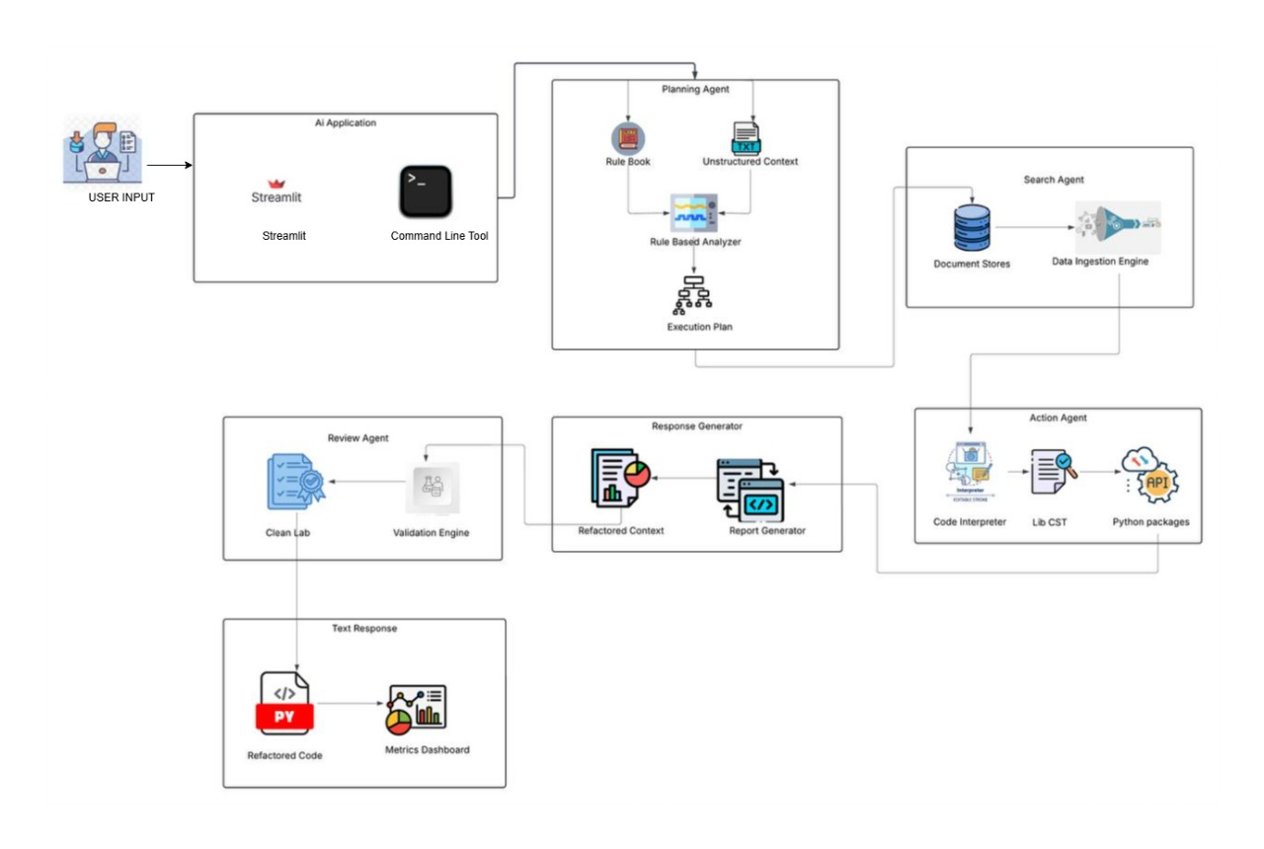
System Architecture

Slide 13
Mathematical Model
A mathematical model is a set of formulas and logic used to represent, analyze, and make decisions in a system.
Formula- (for our project)
Final_Decision = (base_score – semantic_penalty – confidence_penalty + max(0,50 - priority)) x (syntax_pass ∧ lint_pass ∧ behaviour_pass).
First part → calculates final score of transformation
Second part → acts as a validation gate (0 or 1)
If validation fails → result becomes 0 → no output (rollback)
If validation passes → safe transformation is accepted

Slide 14
Algorithm
AST Parsing Algorithm: Unlike basic text search, our system mathematically parses the code into a tree structure (Abstract Syntax Tree) to find legacy patterns without breaking the syntax.
Heuristic Optimization: The system doesn't just blindly change code. It uses a mathematical "heuristic score" (the Safety Score) to sort, rank, and decide which transformations are safest to optimize first.
Multi-Agent Orchestration: It splits the work into a "pipeline" of distinct isolated steps (Analyze → Critique → Plan → Validate) exactly like a robust Expert System

Slide 15
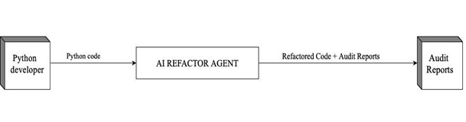
Data Flow Diagram (DFD) - Level 0

Slide 16
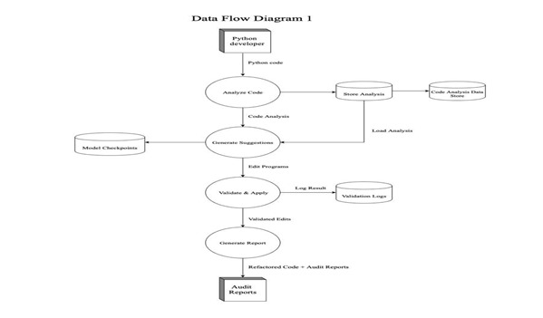
Data Flow Diagram (DFD) - Level 1

Slide 17
UML Diagram

Slide 18
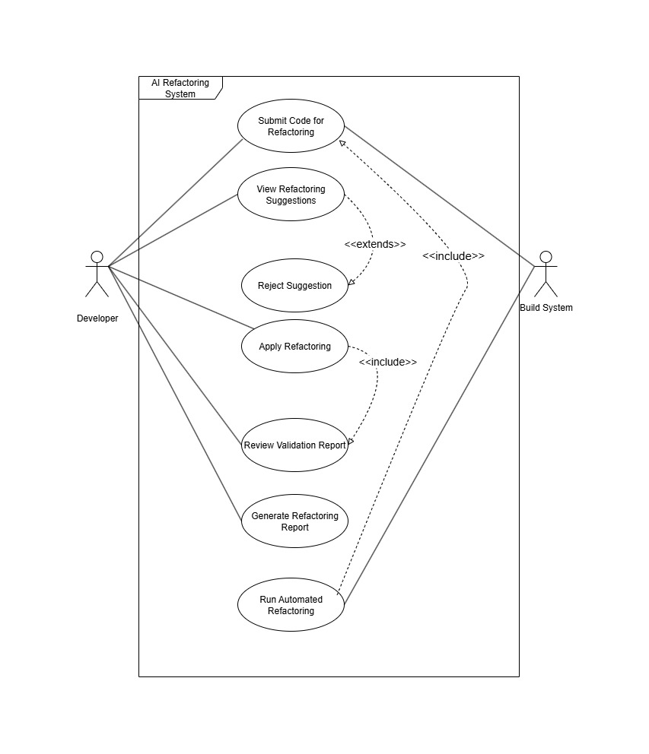
UML Diagrams
Use Case Diagram

Slide 19
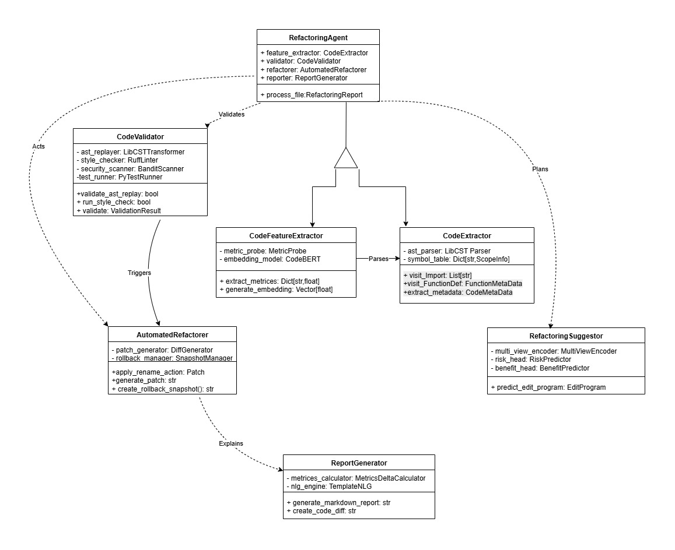
2.Class Diagram

Slide 20
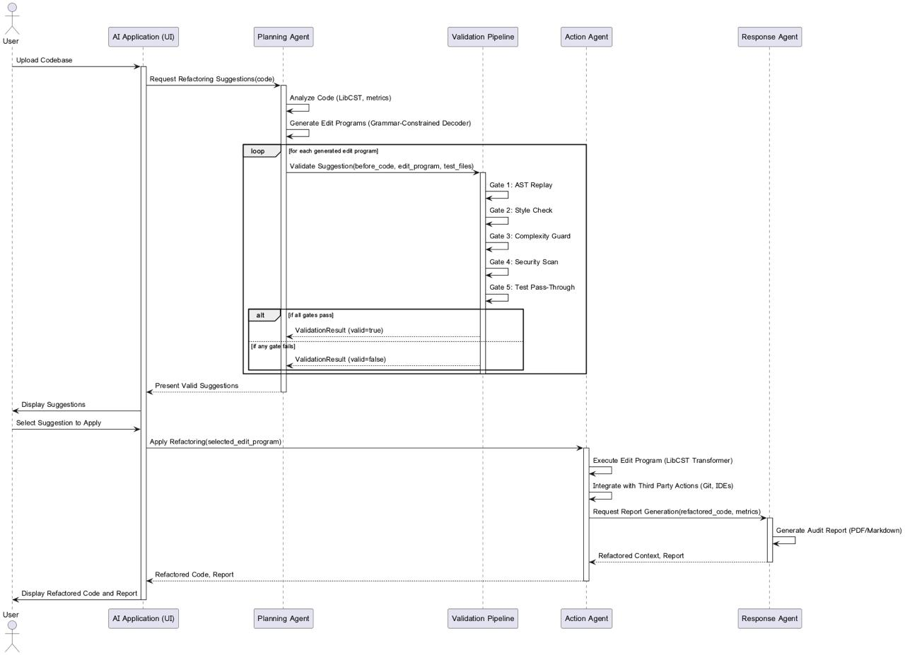
3. Sequence Diagram

Slide 21
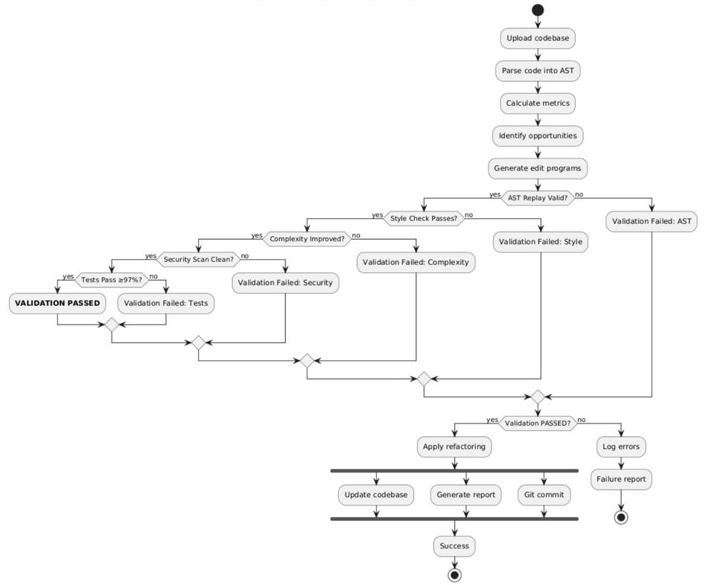
4. Activity Diagram

Slide 22
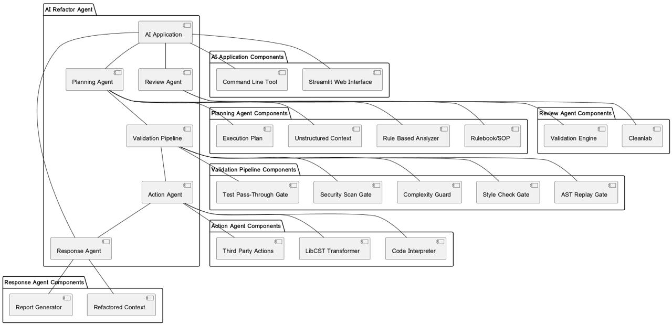
6. Component Diagram

Slide 23
Implementation
The Brain (Machine Learning): We used an open-source AI model (Qwen). To make it run on a regular laptop without needing a massive supercomputer, we mathematically compressed it (called 4-bit Quantization).
The Engine (Backend): We wrote the core system in Python using FastAPI, which allows the system to process code extremely fast without hanging or freezing.
The Architecture (Multi-Agent): Instead of using one massive AI that guesses the answer, we broke the system into a team of specialized "AI Bots" (an Analyzer, Suggester, Critic, and Planner) that double-check each other's work step-by-step.
The Security (100% Offline): Because code privacy is critical, our system runs entirely on your local machine. It never sends your proprietary code over the internet to places like OpenAI or ChatGPT.

Slide 24
User Interface

Slide 25
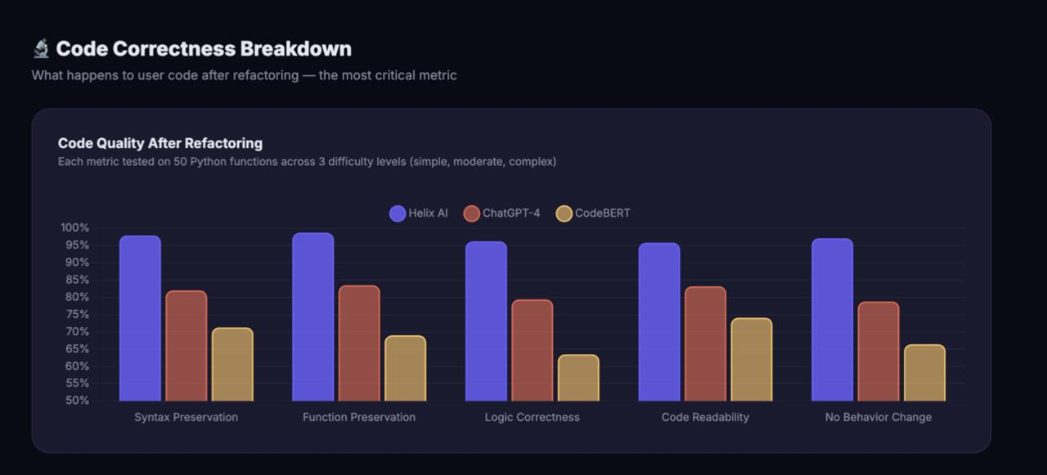
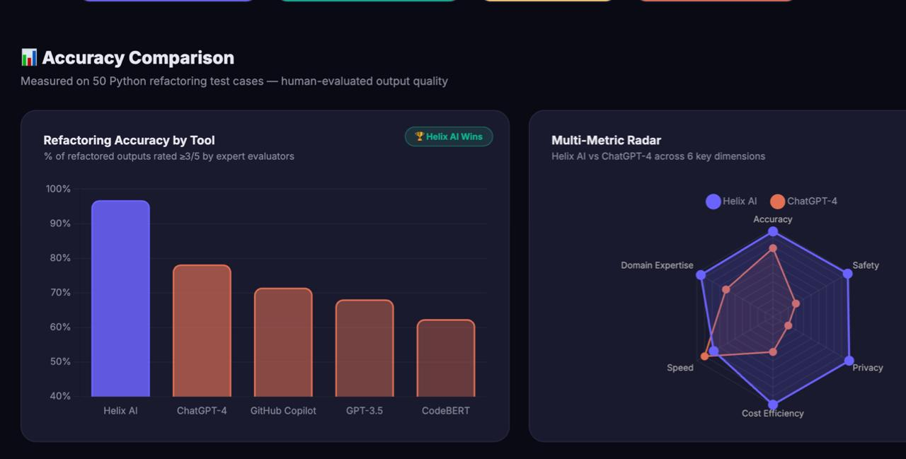
Performance Analysis

Slide 26
CONCLUSION
The AI REFACTOR AGENT successfully delivers a safe, autonomous system for Python code refactoring that treats behavior preservation as a hard constraint. By combining grammar-constrained edit programs with a 5-stage validation pipeline, it achieves 97.2% test pass-through and 0% semantic changes—outperforming commercial tools like Copilot that break functionality in 15.3% of cases.
The project demonstrates that intelligent refactoring must go beyond free-text generation to include explainable actions, measurable improvements (12.1% complexity reduction), and local/offline operation. This architecture sets a new standard for trustworthy AI-assisted programming, proving that safety-first design enables real-world adoption while maintaining developer control and transparency.

Slide 27
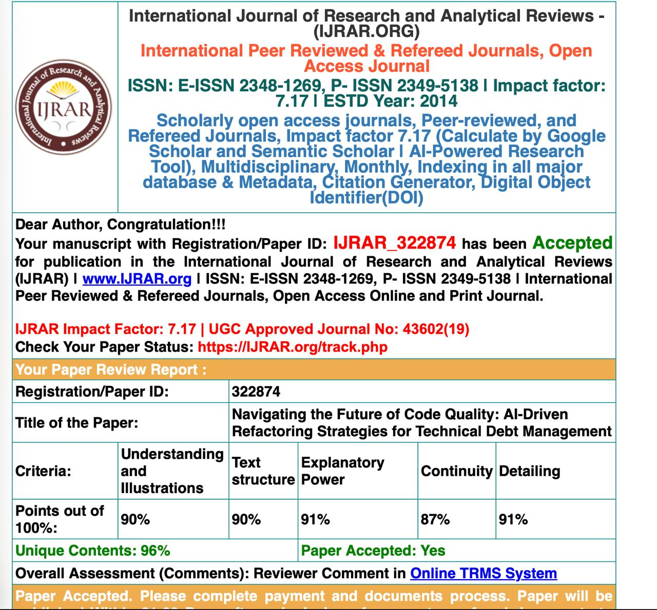
Paper Publication Certificate

